Slide 1
Advanced water and wastewater treatment solutions
Idan Magenn
Project manager Europe
Sep. 2017
Notes:
Environment
Awareness
Policy &
Regulation
Energy
Costs
Disposal
Costs
Water reuse

Slide 2
Global Solution Provider
Aqwise is a trusted solution provider for municipal and industrial customers
>300
>55
Municipal
Installations
Countries
Worldwide
>200
>490M
Industrial
Deployments
m³/year Treated
Wastewater
Notes:
Expertise
Strong biological process know-how
Multidisciplinary expert staff
Global Reach, Local Presence
Over 300 installations in 35 countries
Worldwide regional offices and sales representatives

Slide 3

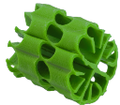
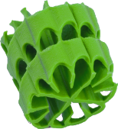
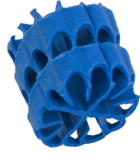
Innovation That Works
Aqwise Biomass Carriers protect biofilm against abrasion and ensure mass transfer efficiency
Recycled, high-density
polyethylene
Optimal oxygen and
nutrients transfer
Highly open
external design
Applicable for various
biological processes
> 650 m²/m³
Effective surface area
Notes:
Aqwise technology is the result of over a decade of multidisciplinary research and development
Innovative biofilm-based technology
Strong IP portfolio
Unique proprietary know-how
Cost efficient, scalable, and eco-friendly
Field-proven in diverse applications

Slide 4
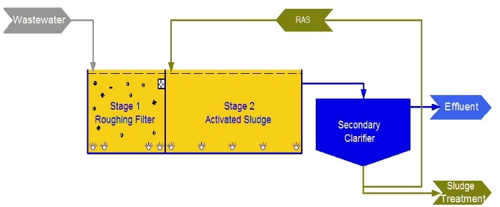
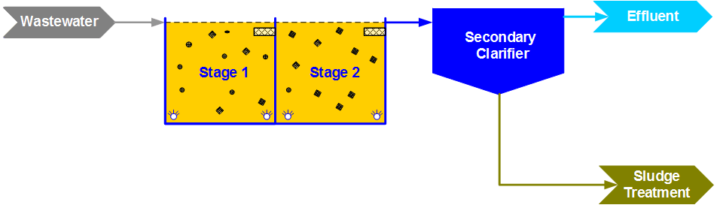
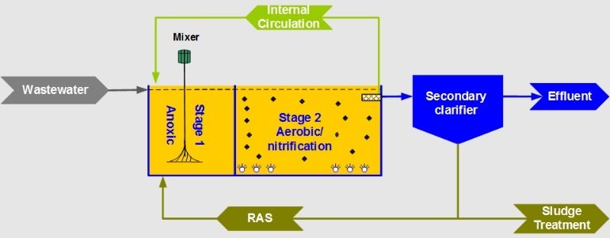
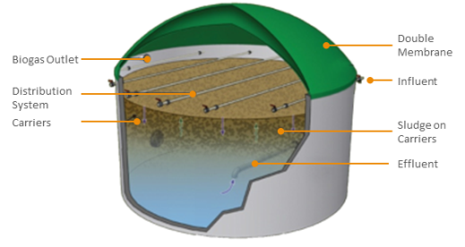
Diverse Biological Processes
AGAR® Aerobic Processes
AGAR® MBBR
AGAR® FFST
DACS® Anaerobic Processes
AGAR® IFAS
DACS®

Slide 5
Aqwise Solution Portfolio
Aqwise supplies adaptable technology and tailor-made solutions for the global markets
MUNICIPAL
INDUSTRIAL
DRINKING WATER
New and upgrade installations
Large or small scale facilities
Full water reuse or discharge
to the environment
High strength wastewater treatment
Wide range of industries
Water reuse & energy recovery
Surface water treatment
Ground water treatment
Environmental approach for
treating a variety of pollutants

Slide 6
Modular compact solution

Slide 7
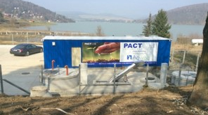
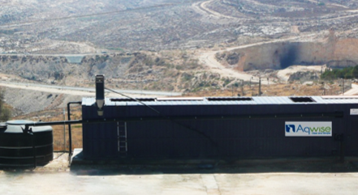
Modular Compact Solutions
.
Cost effective biological process,
Small footprint.
Well proven solution.
Plug & Play approach
Fully automated remote monitored containerized units.
Enabling full reuse or discharge to environment.

Slide 8
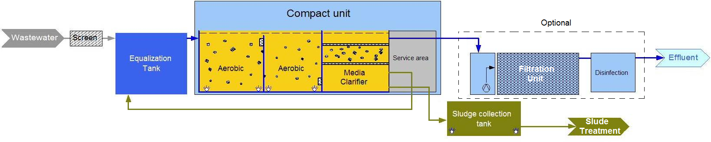
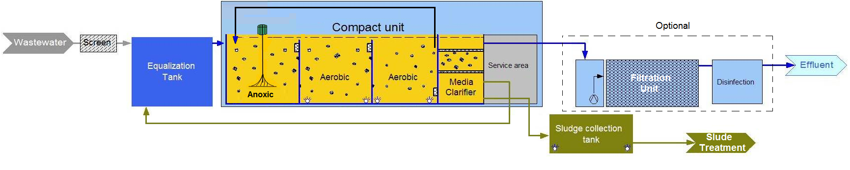
Flow Diagrams
MBBR
/
MBBR-BNR

Slide 9
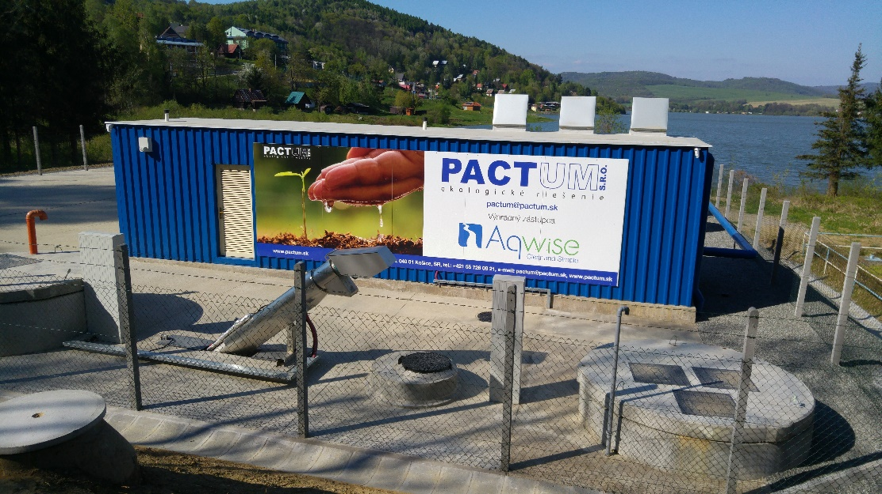
Case Study: Package Plant
Small, remote municipality
Slovakia
30 m³/d
Coping with large flow deviations between winter and summer period
High effluent quality- discharge to lake
AGAR® MBBR configuration
Containerized Plug & Play solution
Proprietary Aqwise Media Clarifier
Insulation for low ambient temperatures
Aqwise Municipal WWTP, Slovakia

Slide 10

Contact Information
Contact us for further information about Aqwise solutions
Idan Magenn
Technical Sales - Europe
Email
idan@aqwise.com
Telephone
+972-9-9591901
+49-162-25252392
Website
www.aqwise.com

