Slide 1


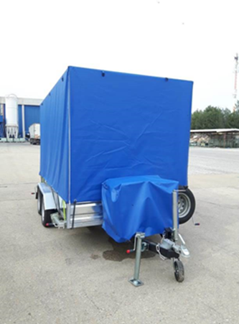
Year: 2019
Client: EPS - Electric Power Industry of Serbia –
Challenge: Emergency cases of Shortage of fresh drinking water (Floods, no electricity…)
Solution: Mobile unit treating 5m³/h, from any source to drinking water. including self generator , filtration system, smart clarifier and 10m³ water tank, all mounted on a trailer/skid.

Slide 2

